Slide 1


Reducing Carbon Footprints

Slide 2



PROBLEM STATEMENT
Global warming and climate change is mostly caused by carbon dioxide emissions.
If we wish to create a future that is sustainable and ensures that everyone has access to a good standard of life, we must consider both the environmental and human welfare implications of carbon emissions.

Slide 3
IMPORTANCE OF PROBLEM
It is becoming imperative that the world needs to reduce carbon emissions effective immediately if we want to mitigate the effects of climate change.
Increasing CO2 emissions have detrimental and long-lasting effects on the environment. There are some individuals who argue that these emissions have traditionally been a direct result of industrialization and improving living conditions.
Since, we cannot stop industrialization and reduce the carbon emissions, our only chance at solving this problem is through carbon offsetting.

Slide 4
Some important terms
Carbon offsetting - Carbon offsets occur when a polluting company buys a carbon credit to make up for the greenhouse gas it has emitted. The money should be used to fund action somewhere in the world that remove the same amount of carbon out of the air, or to prevent carbon emissions.
Carbon credit - Carbon credits, also known as carbon offsets, are permits that allow the owner to emit a certain amount of carbon dioxide or other greenhouse gases. One credit permits the emission of one ton of carbon dioxide or the equivalent in other greenhouse gases.
Retirements - Retiring an offset means it's claimed against an individual or organization's carbon footprint, and it has been taken out of circulation to ensure it can only be claimed once.

Slide 5
ANY PREVIOUS RESEARCH
Allied Offsets is one of the organizations who is currently working in this domain.
Earlier Duc Khuong Nguyen and team has researched about Carbon emissions determinants and forecasting.
Reference for the research : https://www.sciencedirect.com/science/article/pii/S0301479721000505

Slide 6
SOLUTION
Companies are actively participating in carbon compliance market and offsetting the emissions as per government regulations but some companies are going way beyond the level set by government and voluntarily offset more carbon emissions than the government requires to.
Our product will analyze the carbon emissions done by different industries and forecast the credits that will be issued and retired in coming years so that we can target companies which will have less credits remaining in the future.
We will also match those organizations to countries that have projects with available credits.

Slide 7
SOLVING THE PROBLEM
Our analysis on this problem will forecast the gap between carbon emissions and carbon offsets and highlight the many factors(such as our solution) that could lead to differing outcomes.
We would be analyzing CO2 emissions for the countries in different parts of the world and target countries with high emissions.
We will help the organizations in these countries to find suitable carbon offset projects so that they can reduce their carbon footprint.
We will also forecast on issuances vs retirements in voluntary carbon market using LSTM (Long Short-Term Memory) which is a RNN model. We will also explore
ARIMA and SARIMA algorithms for forecasting.

Slide 8
Evaluating the solution
We will use the SMART approach to evaluate the success of our solution.
The amount of carbon emissions offset through our product would be a good quantifiable measure for the success of the project.
At the end of each year, we can check our forecast of issuances and retirements against actual issuances and retirements to see the accuracy of our forecasts.

Slide 9
COMPARING TO EXISTING SOLUTION
There are 2 levels at the moment at which the solution is being implemented-
International organizations such as the United Nations allow the purchase of credits directly.
The credits are sold in private carbon offset exchange markets such as Terrapass.
We shall act as brokers between the sellers and buyers trying to maximize the profit for both the parties using advanced machine learning and data science.

Slide 10
WHO WILL BE THE STAKEHOLDERS
A stakeholder can be a wide variety of people impacted or invested in the project.
As discussed earlier we are the bridge between the sellers and buyers, so we are the prior stakeholders.
Other than that, the customers who are willing to invest in the projects of offsetting carbon emission can also be counted as the stakeholders.
This project has the potential to greatly assist humanity in achieving carbon neutrality, making the entire population a stakeholder.

Slide 11
ESTIMATED IMPACT ON STAKEHOLDERS
As discussed earlier, this project is useful for the entire mankind so the impact is huge on the entire population.
Different companies who are ready to invest on this projects can boost their market image and also a positive impact on the nature.
The carbon offset projects that are being invested in, will generate revenue and bring jobs to the countries where these projects are being hosted.

Slide 12
Data and tools used so far
We gathered the public transit emission data at country level using the gtfs2emis R package and R coding to see which countries were emitting more carbon pollutants.
The Goldman School of Public Policy at the University of California provided carbon offset projects data for voluntary carbon markets.
We then used python to do exploratory data analysis on the different data sets to make sense of the data we collected. The package used most frequently in this was Pandas.
Finally, after cleaning the data for a bit and applying some transformations, we used tableau to create some charts to visualize our data.

Slide 13
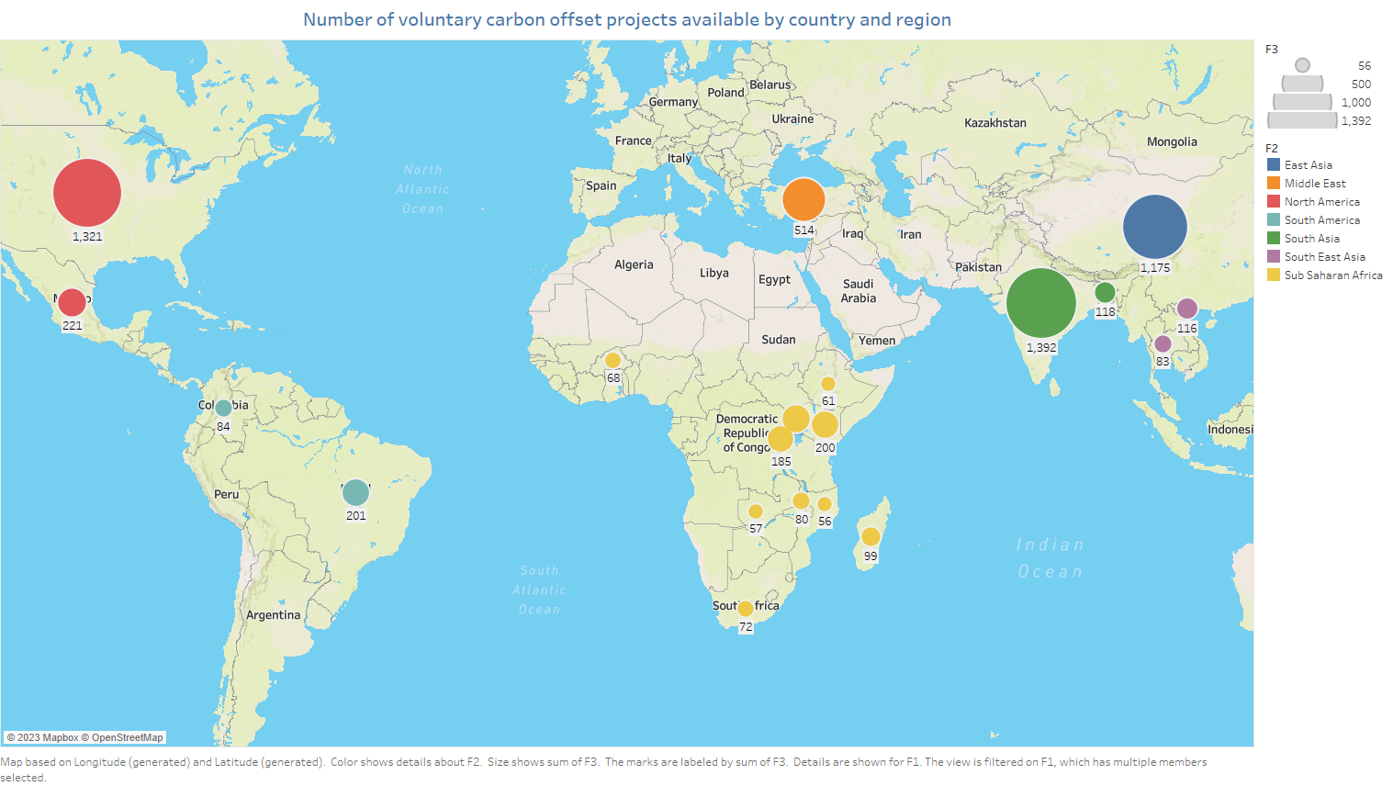
CHART 1
We can see that India is the leader
currently with the maximum number
of offset projects available followed
by the US and China.

Slide 14
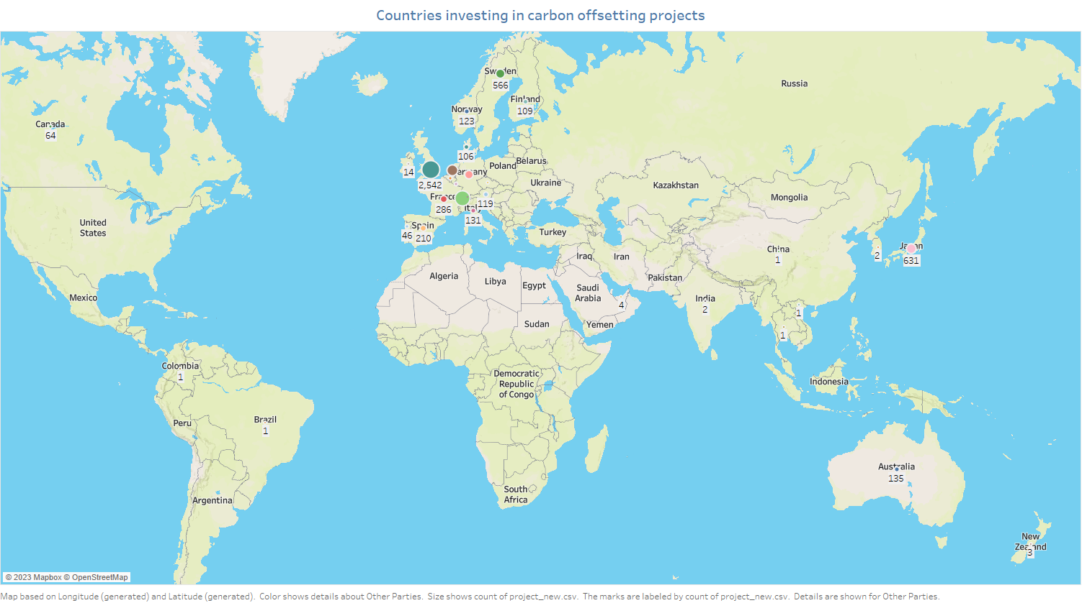
CHART 2
We can see that the UK is the
leader in investing in carbon offset
projects. In general, Europe is doing
really well.
Even Japan is doing well consider-
-ing its small size.

Slide 15
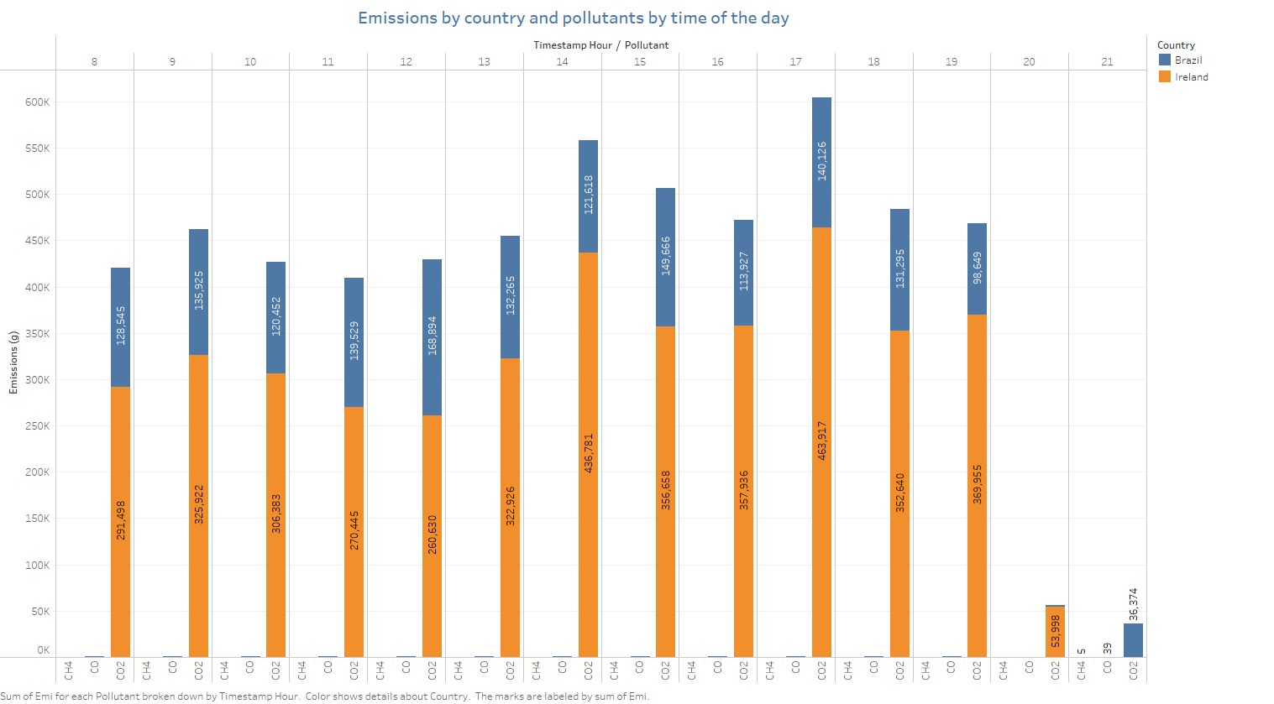
CHART 3
Here we can see that, for public
transportation, the major carbon
based pollutant is carbon dioxide.
Another interesting thing we
observed was that Ireland emits
more than twice the amount of carbon
emitted by Brazil even though the
latter is way bigger.
We also found that one unit of N2O
is equivalent to 298 units of CO2 so
we will factor in other pollutants in later
stages of the analysis.

Slide 16
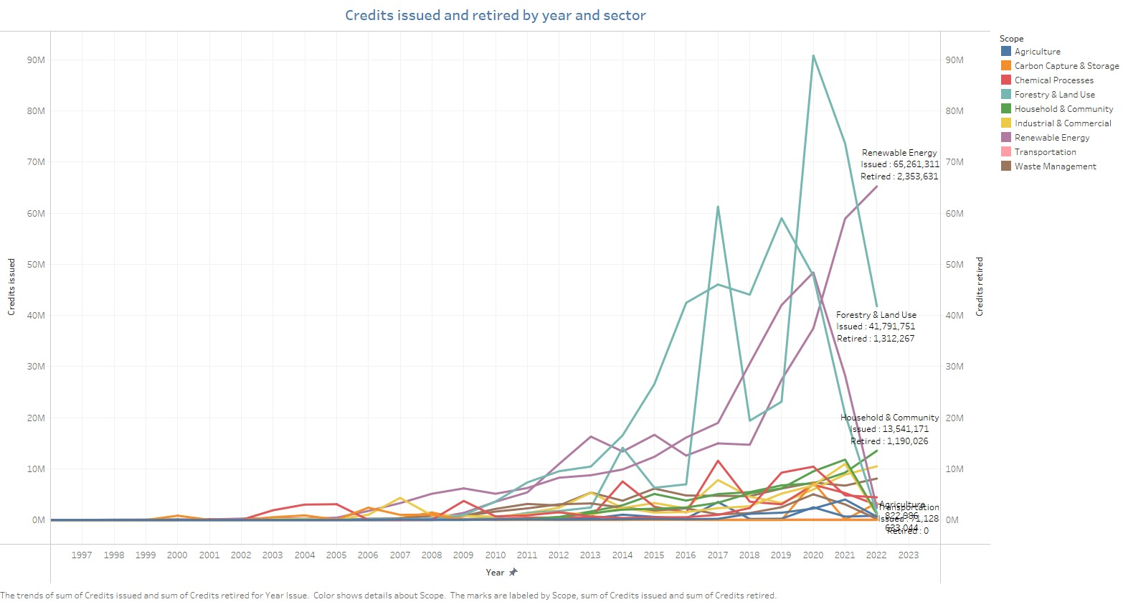
CHART 4
We can see that, the maximum
number of carbon credits
issued and retired are in the
renewable energy sector
followed by forestry and land use..
Afforestation is an obvious way
of offsetting your carbon emissions
but renewable energy was a bit
surprising . After some research,
we found that renewable energy
projects not only help offset carbon
emissions but also generate a lot of
revenue by selling energy and that is
why they are popular.

Slide 17
THANK YOU

